Slide 1

Project Review Phase - II
National Institute of Technology Puducherry
Department of Computer Science and Engineering
Final Review Date: 8th May 2025
Title:
Leveraging Large Language Models for Lung Cancer Classification
Presented By:
Manjari Bhamidi (CS21B1008)
Posa Hemanth Kumar (CS21B1035)
Vasan R (CS21B1052)
Guide:
Dr. Venkatesan M
Associate Professor,
Department of CSE
National Institute of Technology Puducherry

Slide 2
Outline
Introduction
Motivation
Literature Survey
Gaps
Problem Statement
Objectives
Datasets
Methodology
Results & Analysis
Conclusion
Timeline
Publications
References
Individual Contributions

Slide 3
Introduction
This study introduces an automated framework for lung disease classification, achieving a test accuracy of 97.33% using a hybrid CNN+ViT model.
It focuses on classifying four conditions—adenocarcinoma, squamous cell carcinoma, large cell carcinoma, and normal lung tissue—using 1000 CT scans from the LIDC-IDRI dataset.
Precise lesion localization is enabled through a contour-based bounding box mechanism with a scale factor of 0.8.
Comprehensive radiology reports, including diagnostic insights and treatment recommendations, are generated via the Gemini API.
The framework aims to enhance clinical decision-making by providing actionable insights for early lung disease detection and management.

Slide 4
Motivation
Lung diseases like adenocarcinoma and squamous cell carcinoma have high mortality rates, necessitating early and accurate diagnosis.
Manual CT scan interpretation by radiologists is time-consuming and prone to variability, straining clinical workflows.
Existing automated systems often lack precision in classification and lesion localization, limiting their clinical utility.
This study aims to achieve high diagnostic accuracy (97.33%) using a hybrid CNN+ViT model and precise bounding box localization.
Comprehensive radiology reports via the Gemini API are motivated to enhance clinical decision-making and improve patient outcomes.

Slide 5
Literature Survey
Article | Approach | Advantages | Limitations | Remarks
Comparative Analysis of M4CXR, an LLM-Based Chest X-Ray Report Generation Model, and ChatGPT in Radiological Interpretation. Journal of Clinical Medicine;MDPI;2024;[PubMed,3.0]; DOI: 10.3390/jcm13237057 Base Paper: Yes | Evaluated the diagnostic accuracy of M4CXR and ChatGPT-4o on 826 anonymized chest X-rays. Two radiologists assessed performance based on accuracy, false findings, location accuracy, count accuracy, and hallucinations. | M4CXR achieved higher acceptability ratings (60–62%) compared to ChatGPT (42–45%). Superior anatomical localization accuracy (M4CXR: 76–77.5%; ChatGPT: 36–36.5%). | Both systems require further validation for clinical integration. Performance varied in complex cases and with image quality variations. Challenges in handling rare pathological findings and anatomical variations. | Highlights the complementary potential of specialized AI models like M4CXR and general models like ChatGPT in medical diagnostics, emphasizing the need for combined approaches to enhance patient care outcomes.

Slide 6
Literature Survey
Article | Approach | Advantages | Limitations | Remarks
Validation of a Deep Learning Chest X-ray Interpretation Model: Integrating Large-Scale AI and Large Language Models for Comparative Analysis with ChatGPT Diagnostics; MDPI;2024; [PubMed,3.0] DOI: 10.3390/diagnostics14010090 | The study assessed the diagnostic accuracy of KARA-CXR, a deep learning model, and ChatGPT by interpreting 2,000 anonymized chest X-ray images. Two radiologists evaluated the outputs for accuracy, false findings, location inaccuracies, count inaccuracies, and hallucinations. | KARA-CXR demonstrated higher diagnostic accuracy (70.50% and 68.00%) compared to ChatGPT (40.50% and 47.00%). KARA-CXR (0.96) > ChatGPT(0.97) in false findings. | ChatGPT's inability to interpret X-ray images directly without specific prompts. Potential biases due to the single-institution dataset. Lack of a definitive reference standard for chest X-ray interpretations. | The study highlights the superior performance of KARA-CXR over ChatGPT in chest X-ray interpretation, emphasizing the need for specialized AI models in medical diagnostics.

Slide 7
Literature Survey
Article | Approach | Advantages | Limitations | Remarks
Outcome Prediction Using Multi-Modal Information: Integrating Large Language Model-Extracted Clinical Information and Image Analysis Cancers; MDPI; 2024; [PubMed, 4.5] DOI: 10.3390/cancers16132402 | The study assessed five AI-based Large Language Models (LLMs)—Dolly-v2, Vicuna-13b, Llama-2.0-13b, GPT-3.5, and GPT-4.0—for extracting clinical descriptors from bladder cancer patients' medical records. These descriptors, along with features from CT urogram images, were used to create a predictive model (CRD) for five-year survival rates after radical cystectomy. | LLMs achieved high extraction accuracies, with GPT-4.0 reaching up to 97%. Integration of imaging and textual data enhances prognostic assessments. | Study focused on a single cancer type, limiting generalizability. Retrospective design may introduce selection biases. Manual extraction of clinical descriptors was used as a reference standard, which may not be error-free. | The research showcases the potential of combining LLM-extracted clinical information with imaging analysis to improve prognostic modeling in bladder cancer, suggesting a promising direction for AI-assisted personalized medicine.

Slide 8
Literature Survey
Article | Approach/Method | Advantages | Limitations | Remarks
An Early Investigation into the Utility of Multimodal Large Language Models in Medical Imaging IEEE International Conference; Sulaiman Khan, Md. Rafiul Biswas, Alina Murad, Hazrat Ali, and Zubair Shah;2024 DOI: arXiv | Explores the integration of multimodal large language models (MLLMs) in medical imaging for tasks such as diagnostics, analysis, and report generation. | Enhances image interpretation accuracy. Automates radiology workflow. Improves diagnostic efficiency. | Requires extensive training data. Ethical concerns regarding AI in medicine. High computational costs. | MLLMs have potential in medical imaging but need further research to ensure reliability and clinical safety.

Slide 9
Gaps
The current gaps that exist in utilizing Medical Imaging (with & without LLMs) are as follows:
Most deep learning models provide a binary or multi-class classification without explaining the results or adding further context.
Previous models may have biases based on dataset imbalances, leading to misclassification of diseases in underrepresented groups.
Many AI models are developed and tested on benchmark datasets but lack validation in real clinical settings.
Generally, only the utilization of certain Deep learning models is leveraged for Classification as opposed to the recent advancements such as Vision Transformers.
Prior works focus solely on model accuracy but do not compare AI classifications with existing medical literature.

Slide 10
Problem Statement
Lung diseases, including variants of lung cancer such as adenocarcinoma, squamous cell carcinoma, and large cell carcinoma, pose significant diagnostic challenges due to their high mortality rates and the complexity of early detection. Manual interpretation of CT scans by radiologists, while accurate, is often time-intensive, prone to inter-observer variability, and increasingly strained by the growing volume of diagnostic imaging in clinical settings. Existing automated diagnostic systems frequently lack the precision to achieve high classification accuracy across diverse lung conditions, struggle with localizing small or subtle lesions, and fail to provide comprehensive, actionable insights for clinical decision-making. This study addresses the problem of developing an automated framework that integrates advanced deep learning (hybrid CNN+ViT model), precise lesion localization through bounding boxes, and LLM-based radiology report generation (via the Gemini API) to achieve a test accuracy of at least 95%, accurately identify regions of interest, and deliver detailed reports with diagnostic, treatment, and lifestyle recommendations, thereby enhancing the efficiency and reliability of lung disease diagnosis in clinical practice.

Slide 11
Objectives
Develop a hybrid CNN+ViT model to classify lung diseases (adenocarcinoma, squamous cell carcinoma, large cell carcinoma, normal lung) with a test accuracy of at least 95% using 1000 LIDC-IDRI CT scans.
Integrate deep (DenseNet121) and hand-crafted (GLCM, Wavelet, HOG) features for comprehensive image analysis.
Localize lesions accurately, including small patterns, using a contour-based bounding box mechanism (scale factor: 0.8, minimum area: 50).
Generate detailed radiology reports via the Gemini API, including diagnosis, treatment recommendations, and lifestyle advice, formatted as high-quality PDFs.
Evaluate performance using accuracy, precision, recall, and F1-score, with qualitative validation of localization and reports by radiologists to support clinical decision-making.

Slide 12
Objectives
Objective 1: Develop a hybrid CNN+ViT model to classify lung diseases (adenocarcinoma, squamous cell carcinoma, large cell carcinoma, normal lung) with a test accuracy of at least 95% using 1000 LIDC-IDRI CT scans.
Status: Completed
Objective 2: Integrate deep (DenseNet121) and hand-crafted (GLCM, Wavelet, HOG) features for comprehensive image analysis.
Status: Completed
Objective 3: Localize lesions accurately, including small patterns, using a contour-based bounding box mechanism (scale factor: 0.8, minimum area: 50).
Status: Completed

Slide 13
Objectives
Objective 4: Generate detailed radiology reports via the Gemini API, including diagnosis, treatment recommendations, and lifestyle advice, formatted as high-quality PDFs
Status: Completed
Objective 5: Evaluate performance using accuracy, precision, recall, and F1-score, with qualitative validation of localization and reports by radiologists to support clinical decision-making.
Status: Completed

Slide 14
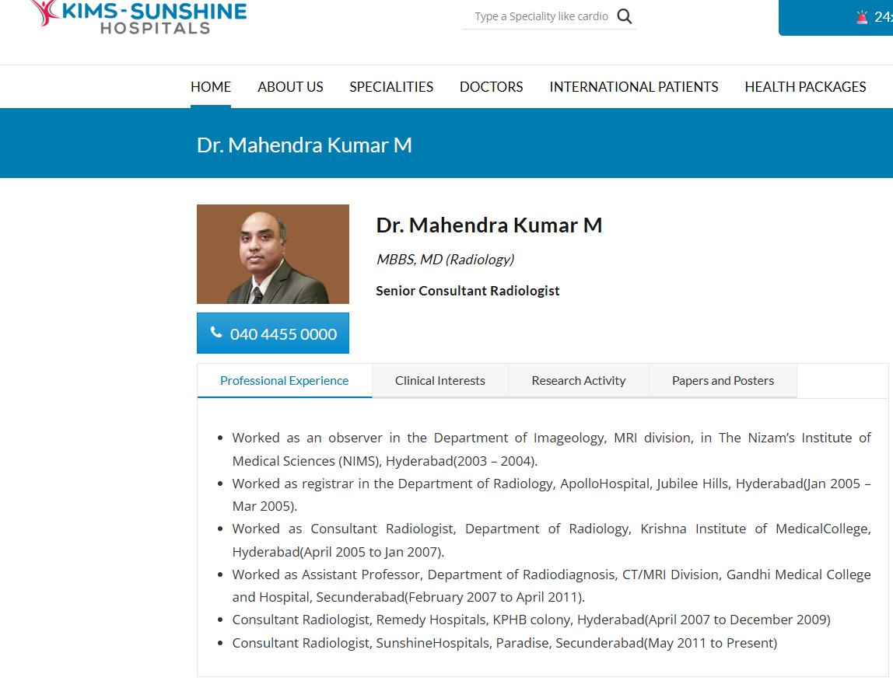
Expert Opinion - Radiologist Profile

Slide 15
Dataset
The experiments utilized the LIDC-IDRI (Lung Image Database Consortium and Image Database Resource Initiative) dataset, a publicly available repository of lung CT scans widely used for lung cancer research.
The dataset was curated to include 1000 CT scan images, divided into 613 training, 72 validation, and 315 test samples. These images were labeled into four classes: adenocarcinoma, squamous cell carcinoma, large cell carcinoma, and normal lung tissue.
Each image was annotated by expert radiologists to ensure diagnostic accuracy, with a focus on balancing the representation of each class to mitigate bias during model training and evaluation.
The images are in grayscale, capturing detailed cross-sectional views of the chest cavity.
Adenocarcinoma: A type of non-small cell lung cancer originating in glandular tissue.
Large Cell Carcinoma: A fast-growing cancer that can appear in any part of the lung.
Squamous Cell Carcinoma: Cancer arising from the squamous cells lining the airways.
Normal: CT scans of healthy lung tissue.

Slide 16
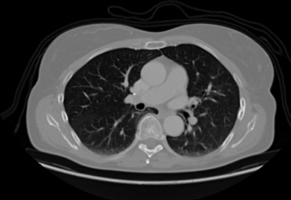
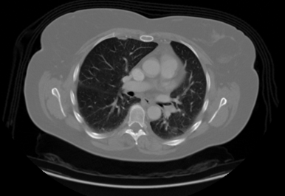
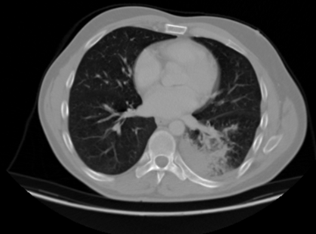
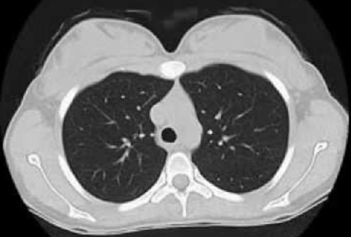
Dataset
Adenocarcinoma
Large Cell Carcinoma
Squamous Cell Carcinoma
Normal

Slide 17
Methodology
CT
Scan
Dataset
Preprocessing
Feature Extraction
Classification
Results
LLM Report Generation + AI Agent
‹#›

Slide 18
CT Scan Dataset
Raw data is essential for all steps, as its quality, size, and class balance directly affect model performance.
Preprocessing
Ensures images are consistent for feature extraction, reducing noise and variability.
Feature Extraction
Transforms raw images into a numerical format that captures deep and hand-crafted patterns.
Classification
Learns to map the extracted features to disease classes.
LLM Report Generation + AI Agent
Translates the model’s prediction into a clinically actionable report.
Results
Provides a comprehensive evaluation of the system, highlighting its strengths (e.g., high accuracy).
‹#›

Slide 19
CT Scan Dataset
1000 CT Scan (Cross-sectional view)
Preprocessing
Resizing, Normalization, Label Encoding, Additional transforms are applied ImageNet (μ and σ)
Feature Extraction
ResNet50, Compared with other models and add Hand-Craft Features.
Classification
CNN + Vision Transformer
LLM Report Generation + AI Agent
Observations, Interpretation, Diagnosis, treatment recommendations, nutritional guidance, and physical activity advice.
Results
Test Accuracy: 97.33%, Report PDF.
‹#›

Slide 20
Methodology
This methodology outlines the steps involved in processing Medical CT-Scan Dataset for classification and interpretation using Neural Networks and Large Language Models (LLMs). The workflow consists of the following stages:
Medical CT-Scan Dataset:
The dataset is organized into train, validation, and test directories, each containing subfolders for classes like adenocarcinoma and normal.
Train: 613 images, Validation: 72 images, Test: 315 images.
Preprocessing:
Images are loaded in grayscale using OpenCV, resized to a fixed dimension (e.g., 224x224 or 299x299). Pixel values are normalized by dividing by 255. For deep learning, extra transforms like and normalizing with ImageNet statistics are applied. Labels are extracted from the directory structure and encoded numerically, often using LabelEncoder.

Slide 21
Methodology
3. Feature Extraction:
Deep Features:
Pre-trained models (ResNet50, InceptionV3, EfficientNetB0, DenseNet121, Molmo-7B-D) serve as feature extractors by removing the final fully connected layers and flattening the last convolutional layer output.
Hand-Crafted Features:
GLCM: Analyzes texture features such as contrast and dissimilarity.
Wavelet Transform: Extracts frequency features with Haar wavelets.
HOG: Captures edge and gradient information.
4. Classification:
A ViT-based neural network is used for classification, with features standardized via StandardScaler. The model trains for 50 epochs and performance is evaluated using accuracy, precision, recall, F1-score, and a confusion matrix.
5. Results:
DenseNet121 achieved 91% accuracy, while DenseNet121 reached 91%. Training accuracy ~99%, validation accuracy ~90% with some fluctuations. Test accuracy of 93%, F1-scores ranged from 0.88 to 0.99 across classes. A PDF report detailing the prediction, confidence, and findings.

Slide 22
Results & Analysis
Feature Extraction Models:
Model | Accuracy | Precision | Recall | F1-Score
ResNet50 | 0.59 | 0.59 | 0.59 | 0.58
InceptionV3 | 0.58 | 0.58 | 0.58 | 0.57
EfficientNetB0 | 0.57 | 0.56 | 0.57 | 0.56
DenseNet121 | 0.91 | 0.91 | 0.91 | 0.91
Molmo-7B-D | 0.59 | 0.59 | 0.59 | 0.58

Slide 23
Results & Analysis
Classification Models:
Model | Train Accuracy | Validation Accuracy | Test Accuracy
CNN | 99.98 | 92.67 | 86.67
Vision Transformer | 99.57 | 94.00 | 93.33
CNN+Vision Transformer | 99.98 | 99.33 | 97.33

Slide 24
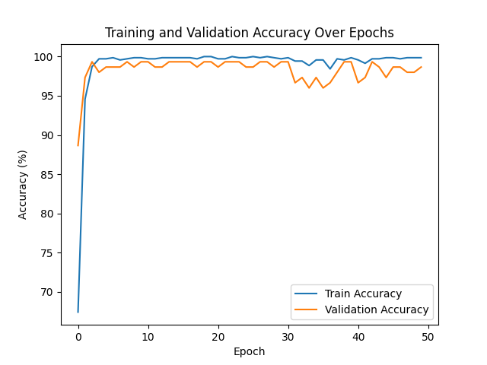
Results & Analysis

Slide 25
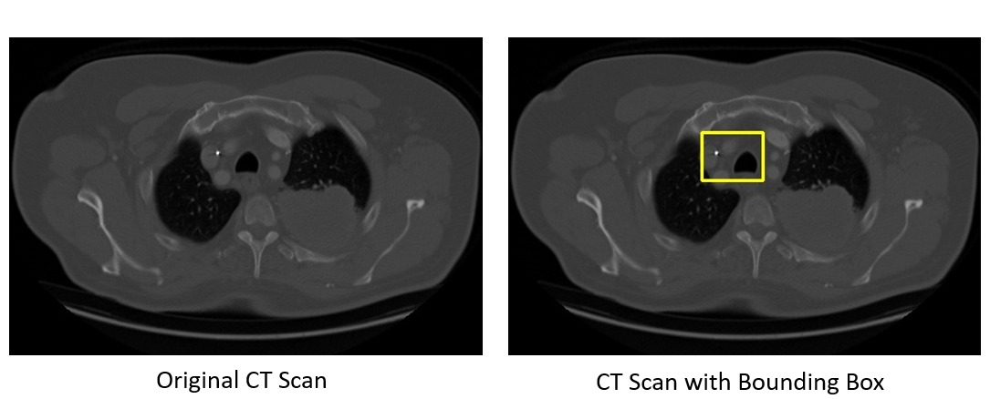
Results & Analysis

Slide 26
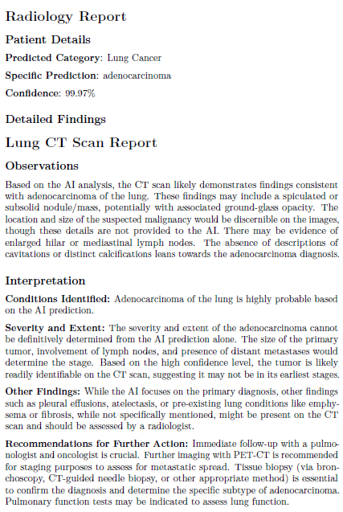
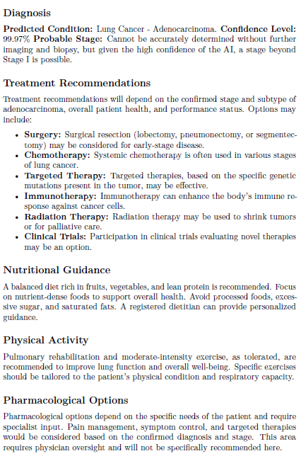
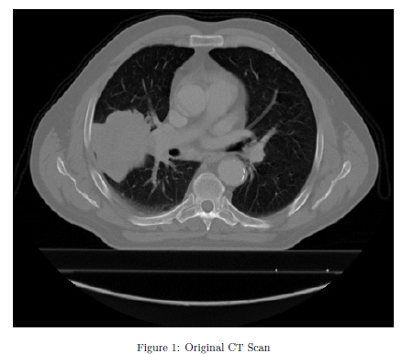
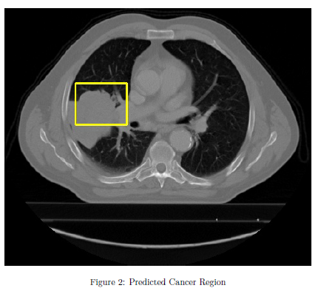
Results & Analysis
Upon running of this program, we generate a PDF of a Radiology report that gives a detailed view of the response delivered by the LLM with the predicted Lung Disease and other details that offer explanations for the interpretation, recommendations etc. An example of the generated report is given below:

Slide 27
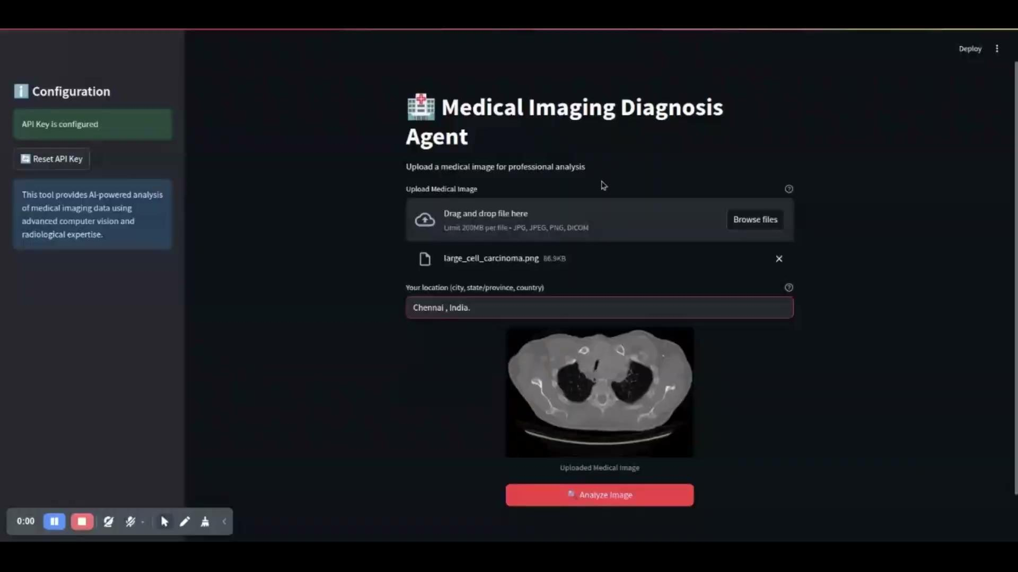

Slide 28
Conclusion
Deep learning-based lung disease categorization combined with Large Language Models (LLMs) may help close the gap between AI-driven diagnoses and practical clinical usage. Although chest X-ray pictures may be used to accurately categorize lung ailments using deep learning models, these algorithms frequently lack interpretability, which makes it challenging for medical personnel to trust and act upon their predictions. This study improves the explainability of AI-generated diagnoses, delivers confidence-based insights, and makes actionable suggestions by utilizing LLMs post-classification. In the end, this improves decision-making and communication between doctors and patients.
In addition to guaranteeing more understandable and transparent AI predictions, this strategy helps healthcare operations incorporate AI more smoothly, which lowers diagnostic mistakes and improves patient care. Expanding the dataset, adding multi-modal inputs (such as patient history and symptoms), and improving LLM outputs for even higher clinical dependability can be the main goals of future research.

Slide 29
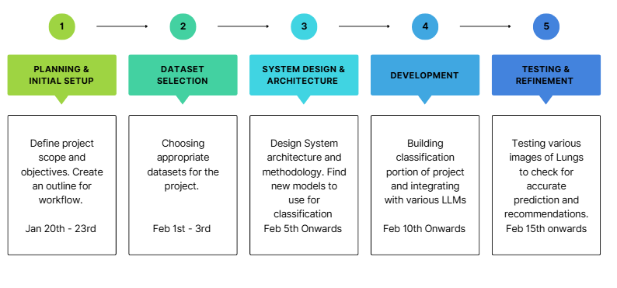
Timeline
Utilizing Agile methodology of working, meaning improving the results of the project via multiple iterations.

Slide 30
References
[1] Khan, Sulaiman, et al. "An Early Investigation into the Utility of Multimodal Large Language Models in Medical Imaging." arXiv preprint arXiv:2406.00667 (2024).
[2] Ali, Hazrat, et al. "ChatGPT and Large Language Models in Healthcare: Opportunities and Risks." 2023 IEEE International Conference on Artificial Intelligence, Blockchain, and Internet of Things (AIBThings). IEEE, 2023.
[3] Meskó, Bertalan. "The impact of multimodal large language models on health care’s future." Journal of medical Internet research 25 (2023): e52865.
[4] Ali, Hazrat, Shafaq Murad, and Zubair Shah. "Spot the fake lungs: Generating synthetic medical images using neural diffusion models." Irish Conference on Artificial Intelligence and Cognitive Science. Cham: Springer Nature Switzerland, 2022.
[5] Masalkhi, Mouayad, et al. "Google DeepMind’s gemini AI versus ChatGPT: A comparative analysis in ophthalmology." Eye (2024): 1-6.

Slide 31
Individual Contributions
Manjari Bhamidi (CS21B1008) – Code Implementation, Dataset, Neural Network,Classification, Documentation
Posa Hemanth Kumar (CS21B1035) – Code Implementation, Literature Survey, Methodology, Preprocessing Models, Documentation
Vasan R (CS21B1052) – Code Implementation, Setup, AI agent, Documentation

Slide 32
Thank You

Slide 33
Question & Answer

